Slide 1


JAYPEE UNIVERSITY OF INFORMATION TECHNOLOGY
Library Management System
Project Category: In-House
Batch: CS43
Guide:
Dr. Sunil Datt Sharma
SUBMITTED BY:
Name: VAIBHAV GUPTA
Department of CSE&IT, ECE

Slide 2

INTRODUCTION
The “Library Management System” is a software that uses to maintain the record of the library.
Library Management System is a software used to manages the catalog of a library.
This helps to keep the records of whole transactions of the books available in the library.
Library Management handling the records of books and readers.
It provides Books for large number of readers.
Department of CSE&IT, ECE

Slide 3
MOTIVATION
In the digital world where education sector is working towards making its space automated, why should libraries still operate the old school way?
Hence Library Management System can transform the manually operating libraries into automated ones seamlessly making it efficient & effective at the same time.
This motivated us to make Library Management automated by developing user friendly application to manage book records where all the transaction details are in one place and save lot of time by avoiding manual power.
Department of CSE&IT, ECE
3

Slide 4

EXISTING SYSTEM
Process of keeping maintaining and retrieving the information
was very slow and lenthy
issue/return information is difficult to maintain
Fast retrieval of information is not possible
Tracing a book/article is difficult
Department of CSE&IT, ECE

Slide 5
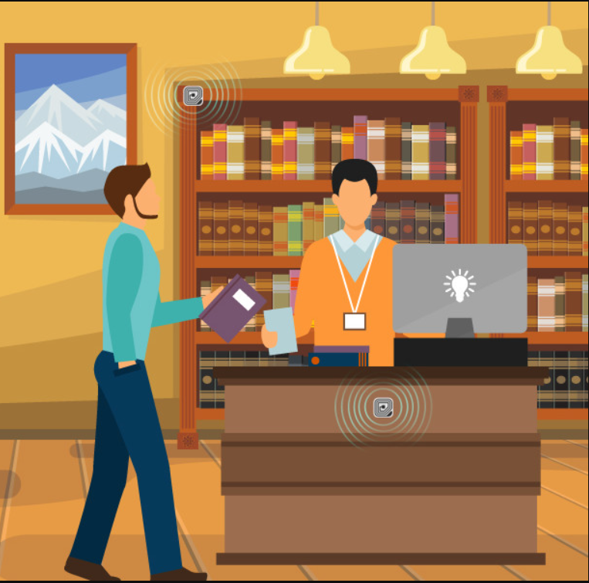
PROPOSED SYSTEM
To eliminate the paper work in library
To record every transaction in computerized system
To design a user friendly graphical user interface for the user to save the time
Students gets all the information at one place and do not
have to go to library to retrieve the transaction details
Department of CSE&IT, ECE

Slide 6
PROJECT OBJECTIVES
The objective of the "Library Management Software" is to handle the entire activity of a library. The software keeps track of all the information about the books in the library, their complete details and total number of books available in the Library.
Maintain issue and return dates of all the transactions.
To provide secure system
The user will find it easy in this automated system rather than using the manual writing system. The system contains a database where all the information will be stored safely. The system is user-friendly and error free.
Department of CSE&IT, ECE

Slide 7
PROJECT SCOPE
• Any education institute and government office's can make use of it for providing information about author, content of the available books etc.
• This project can further be extended by adding the facility of e-book's, to overcome the problem of book stock in library.
Department of CSE&IT, ECE

Slide 8
PROJECT DESCRIPTION
Library Management System divided in two modules
ADMIN
⦁ Admin Dashboard.
⦁ Admin can add/update/delete article.
⦁ Admin can add/update/delete author.
⦁ Admin can add/update/delete books.
⦁ Admin can issue a new book or articles to student and also update the details when student return book.
⦁ Admin can also view student details.
Department of CSE&IT, ECE

Slide 9
USER:
⦁ User can register themselves.
⦁ User can view the book or articles present in the library.
⦁ User can view issued book and book return date-time.
⦁ User can check whether the book is returned or not.
Department of CSE&IT, ECE

Slide 10
FEATURES OF PROJECT:
⦁ LMS is windows based Library management software. Provides password facility for different users to ensure high level of security.
⦁ Single database management system.
⦁ Add, Modify and delete the book's and member's record.
⦁ View the records of book's stock, member's and issued book’s.
⦁ It is completely user friendly Library management software.
⦁ Huge data storage with less computer memory.
⦁ More efficient & reliable.
Department of CSE&IT, ECE

Slide 11
Functional and Non-Functional Requirements
Functional Requirements:
• The system must only allow user with valid ID and password to enter the system.
• System must be able to filter book based on the key word entered.
• System must be able to enter issue information in database.
• System must be able to update the number of books
• System must be able to display the fine amount after the due date as given by the admin.
Department of CSE&IT, ECE

Slide 12
Non-Functional Requirements:
• System ensures security through authentication.
• System will maintain reliability by displaying error messages.
• System is more scalable and flexible as compared to manual system.
• System is very user friendly by providing user and admin with easy option of transaction.
Department of CSE&IT, ECE

Slide 13
ADVANTAGES OF PROJECT
Less Minimize handwritten work.
It helps you to minimize your repeated works and take care of the complete functionality of your Library.
It is a huge time saver and facilitates proper communication among the management, staff.
Provide computerized system for maintaining records.
Avoid human storage with less computer memory.
Department of CSE&IT, ECE

Slide 14
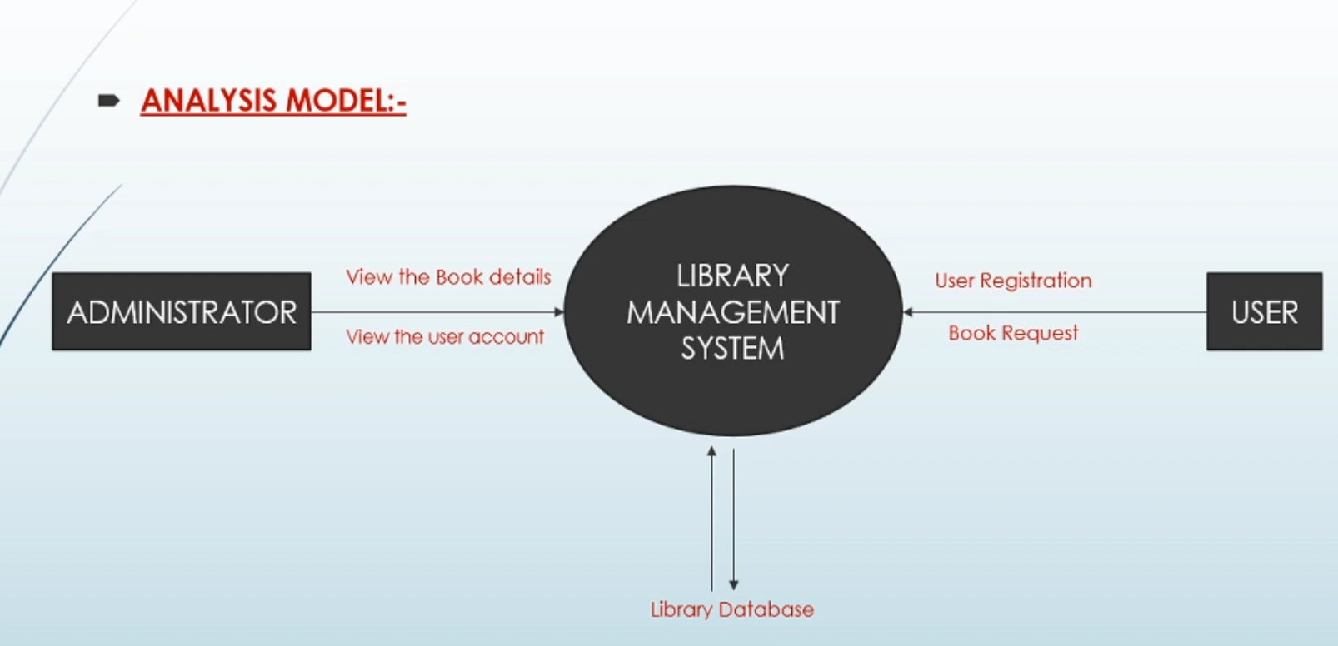














LIBRARY MANAGEMENT SYSTEM
Department of CSE&IT, ECE

Slide 15
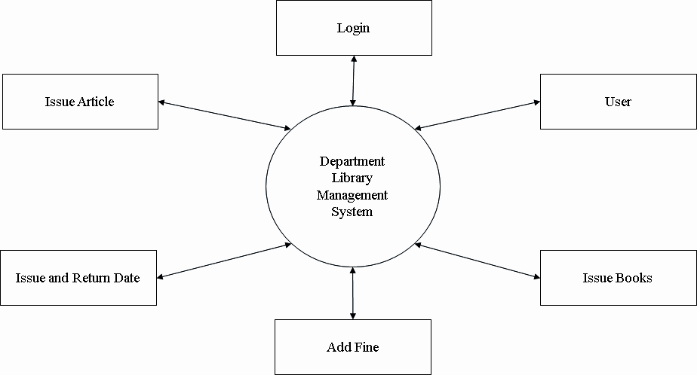
SUBSYSTEMS AND MODULES
Block Diagram:
Department of CSE&IT, ECE

Slide 16
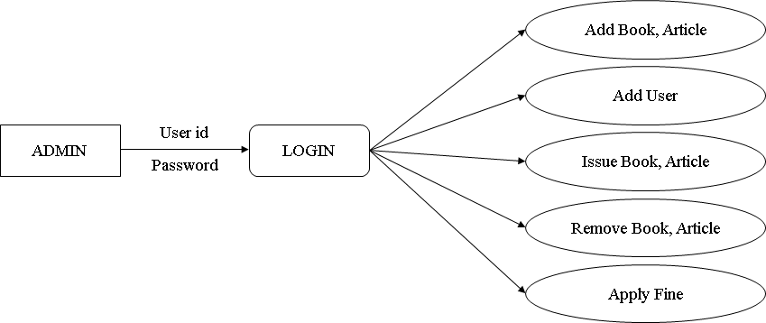








Admin:
Department of CSE&IT, ECE

Slide 17
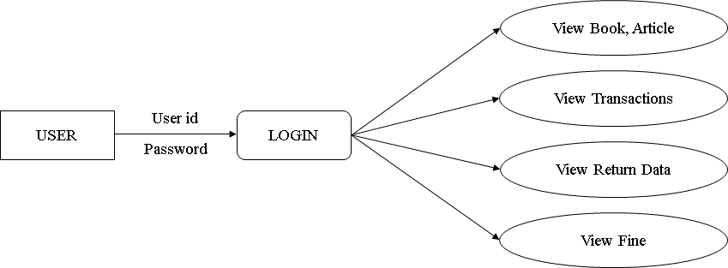




User:
Department of CSE&IT, ECE

Slide 18

HARDWARE & SOFTWARE
REQUIREMENTS
Software Requirements:
• Front End Language: HTML and CSS
• Back End Language: PHP and MYSQL
• Web Server: XAMPP
• Operating System: Windows 10 and above.
Hardware Requirements:
• Processor: CORE i3 and above.
• RAM: 4GB RAM or more.
• Memory: 8GB or more.
Department of CSE&IT, ECE

Slide 19


